Slide 1
DATA CO SUPPLY CHAIN ANALYSIS
TEAM MEMBERS:
VAMSHI AMMULA
JAGRUTH SIDDAGANGAPPA
HEMAL REDDY ATMAKUR

Slide 2
Topics
Introduction
Motivation
Data Schema
Tools and Techniques used
Data Visualizations
.

Slide 3
Introduction
Supply chain refers to the processes involved in producing and distributing a product or service to the consumer.
The better the supply chain management, the more of a competitive advantage the company has in the market.
The dataset considered contains supply chain management used by a company DataCo for clothing, sports equipment, and electronics.
.

Slide 4
Motivation
Effective supply chain management allows an organization to reduce operating costs and streamline its operations which in turn improves customer satisfaction.
By using different data mining techniques, we can further expand this project and discover more insights.
Creation of various charts displaying the sales report, the profit in various months, etc.

Slide 5
Data Schema
CustomerDetails – contains customer information such as CustomerID, Fname, Lname, Segment, Address, CityID, Zipcode.
DepartmentDetails – contains DepartmentID and Department.
CategoryDetails – contains CategoryID, Category, DepartmentID.
ProductDetails – contains ProductID, Product, CategoryID and ProductUnitPrice.
MarketDetails – contains MarketID and the Market.
RegionDetails – contains RegionID, order Region and the corresponding Market ID.
CountryDetails – contains the CountryID, Country and RegionID.

Slide 6
Data Schema
StateDetails – contains StateID, State, and corresponding country ID.
CityDetails – contains CityID, City and corresponding state ID.
VendorDetails – contains VendorID, CityID and zip code.
OrderDetails – contains ItemID, OrderID, VendorID, ProductID, ItemDiscountRate, ItemQuantity, ProfitpreItem and Sales.
ShippingDetails – contains OrderID, CustomerID, OrderStatus, PaymentType, OrderDate, ActualNoDays, EstimateNoDays, DeliveryStatus, LateRisk, ShippingDate and ShippingMode.

Slide 7
Tools and Techniques used
Python
Plotly Library
SQL
SQLite

Slide 8
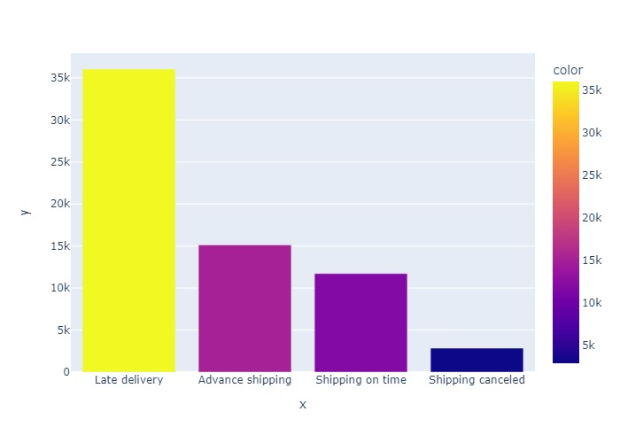
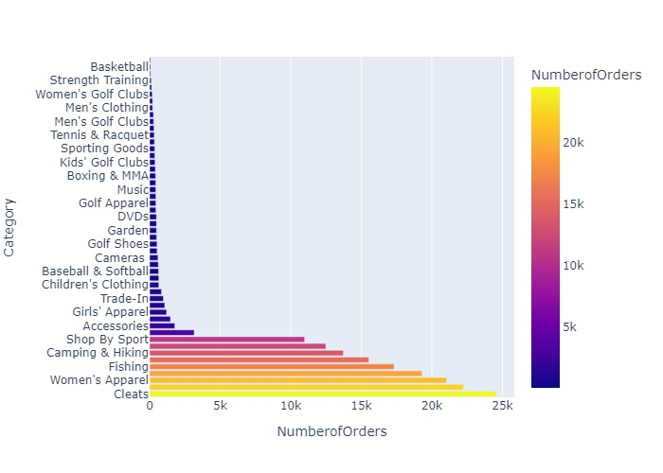
Visualizations
Delivery Status Vs Number of Orders
Categories Vs Number of Orders

Slide 9
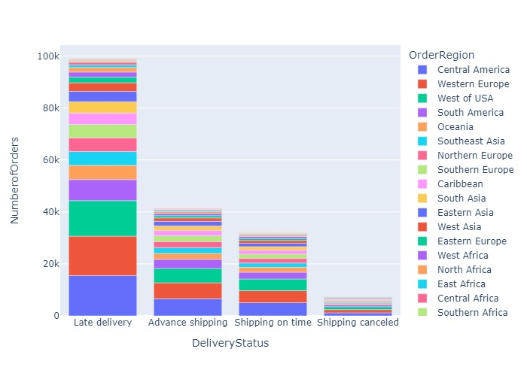
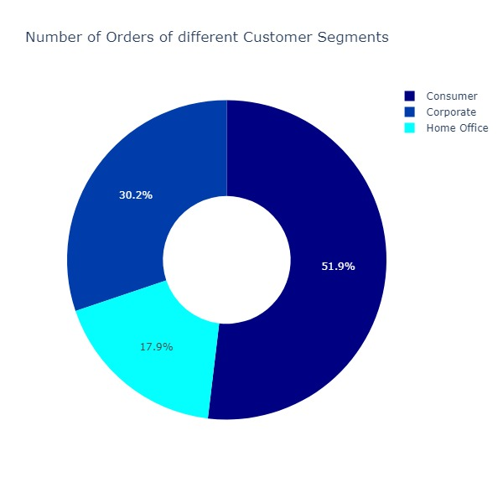
Visualizations
Delivery Status Vs Number of Orders based on Region
Customer Segments Vs Number of Orders

Slide 10
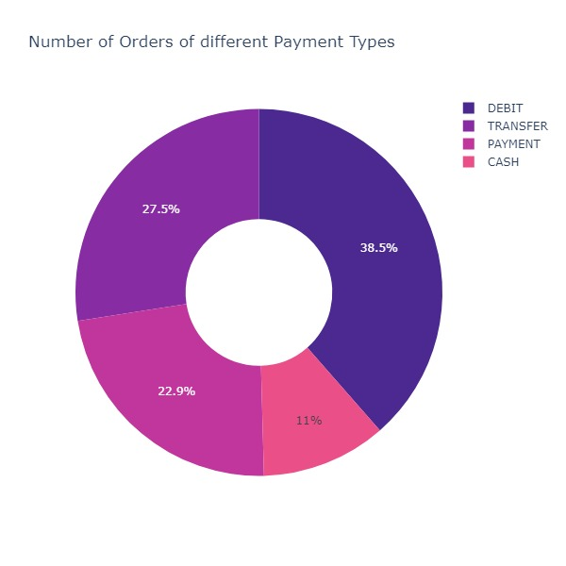
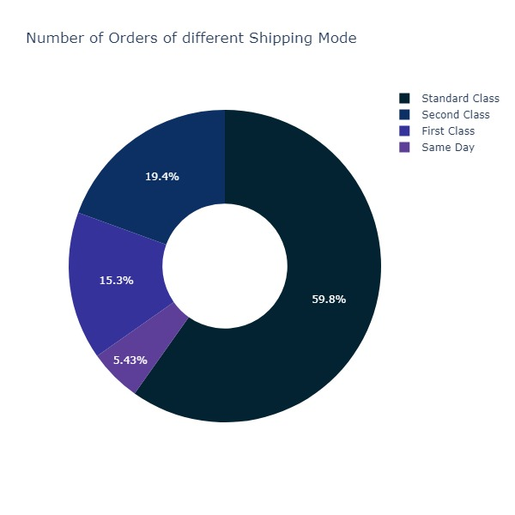
Visualizations
Payment Types Vs Number of Orders
Shipping Mode Vs Number of Orders

Slide 11
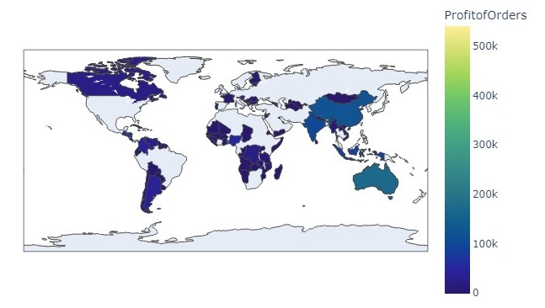
Visualizations
Country Profit Orders

Slide 12
THANK YOU

